Slide 1


How might we enable the future of television that leverages the internet to augment live TV, movies, events, news and sports?
Sprint One | Team 70 | Code Name - Osprey

Slide 2
TV Social Community
From our 20 in-depth interviews
Multitasking while watching TV: texting (people are lonely)
Personalized Recommendation VS. Word of Mouth
Shared login credentials
Functions
Live commenting in streaming TV
Sharing ratings and recommendations with friends
...
Notes:
Friends chosen by the USER Amy, can recommend movies to Amy. Friends can chat about movies that they are currently watching/like.
Finding “new friends” feature based on the similarity of movies that people watch.
AT&T creates a way for like-minded people to meet and interact by booking tickets to new movies for all these selected members.

Slide 3
TV Social Community
Why is it doable?
Successful products integrating live commenting feature: bilibili, Instagram story live etc.
Algorithm-based “friends are watching”
Better App integration for typing in comments and quick rating
Users can sync their rating and comments from other social media platforms
Notes:
Friends chosen by the USER Amy, can recommend movies to Amy. Friends can chat about movies that they are currently watching/like.
Finding “new friends” feature based on the similarity of movies that people watch.
AT&T creates a way for like-minded people to meet and interact by booking tickets to new movies for all these selected members.
AI based algorithm to match strangers with common movie interests. The algorithm then “schedules” a common live movie experience for this group :p

Slide 4
TV Social Community
Speculative future
Community groups based on common interests
Connecting people to watch shows together
Notes:
Friends chosen by the USER Amy, can recommend movies to Amy. Friends can chat about movies that they are currently watching/like.
Finding “new friends” feature based on the similarity of movies that people watch.
AT&T creates a way for like-minded people to meet and interact by booking tickets to new movies for all these selected members.

Slide 5
2. Integrate Web Search Feature
Search for terminology
Info about story, actors, rating, etc.

Slide 6

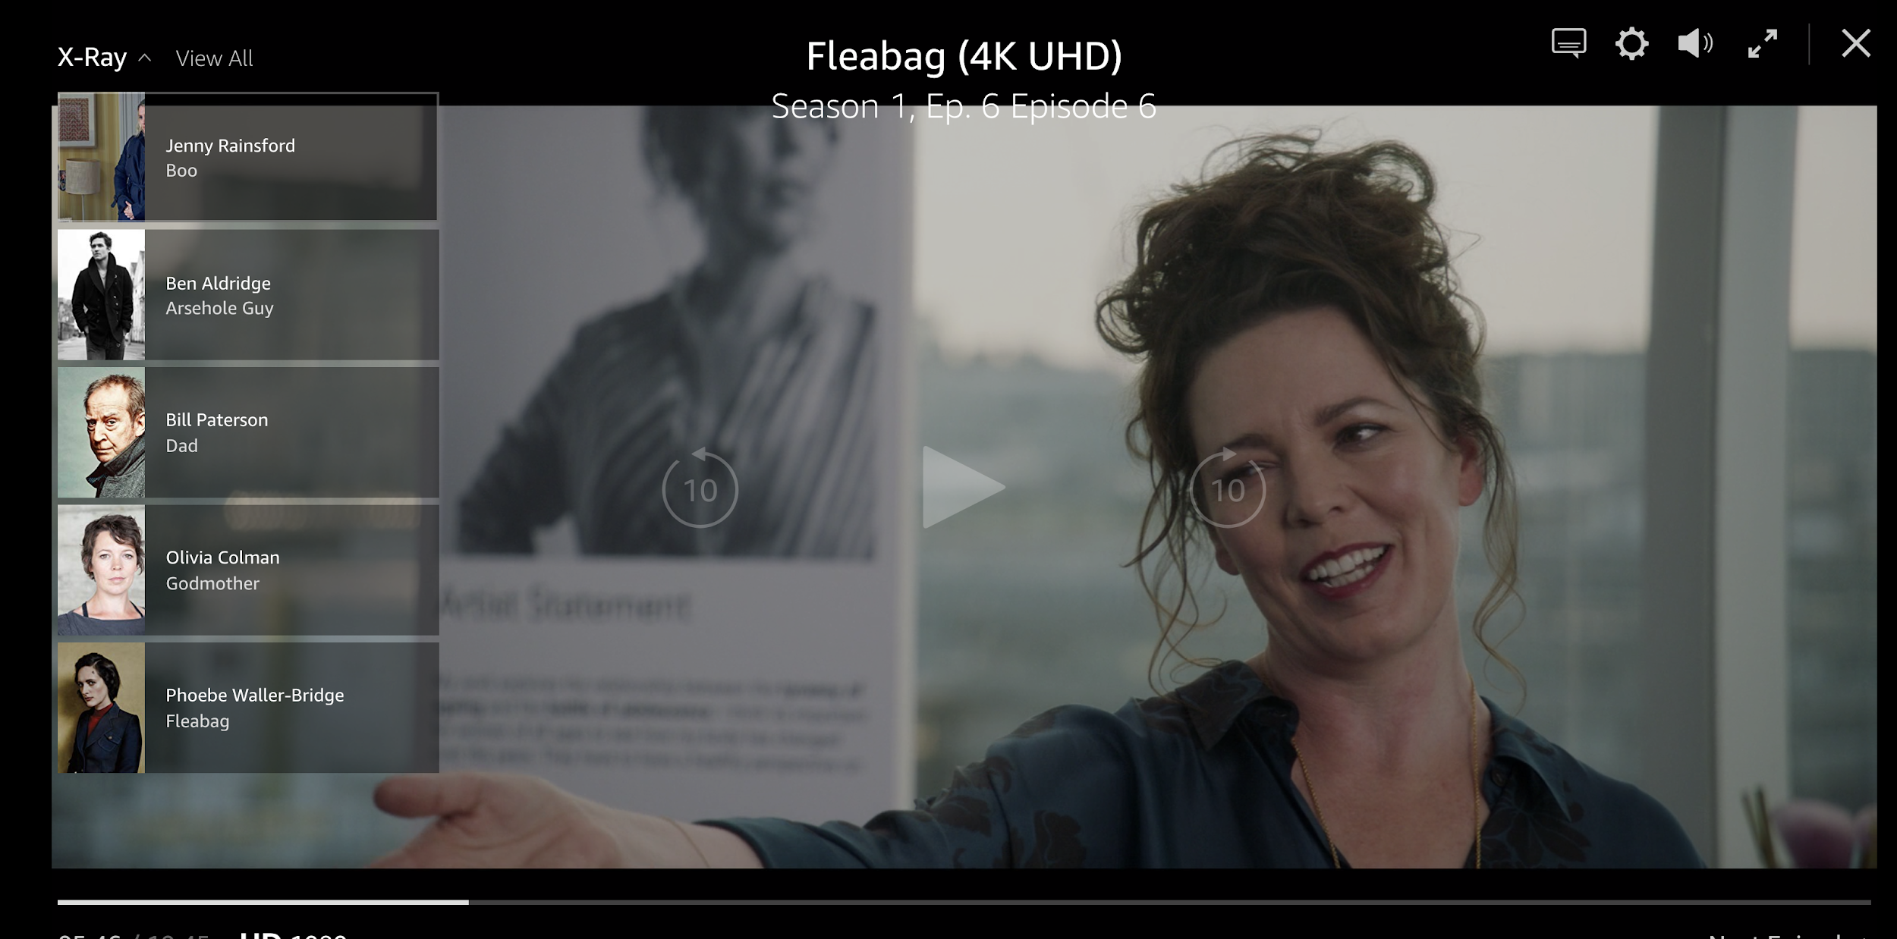

2. Integrate Web Search Feature
Automatic Search functionality
Voice Assistant Search
Notes:
More inclusive watching experience
Ask through voice assistant; integrate w/ google search/wikipedia
Overlay display on/Split screen of the search result
On mobile screen better?
Pull rating/info from website; let the users get a hang of
TV show
TV programs
More Content like this
https://www.amazon.com/Episode-1/dp/B01KW5KHJG/ref=sr_1_1?keywords=fleabag&qid=1569557852&s=gateway&sr=8-1
Pause screen and get info of people on the screen, links to their other films etc, the products they are wearing with links to shopping etc.

Slide 7


3. Phone as a Remote
Present Day Remote Control
Cumbersome content search
Terrible interaction with the internet.
Notes:
Original Slide. Make a copy and edit please :)

Slide 8





3. Phone as a Remote
Future: Phone acts as a remote.
Ease of search for favourite applications
Order food online
Play your favourite music/movies
Integrated with google assistant features
And most importantly, navigate for your shows with EASE.
Notes:
Original Slide. Make a copy and edit please :)

Slide 9

Welcome to the future

Slide 10
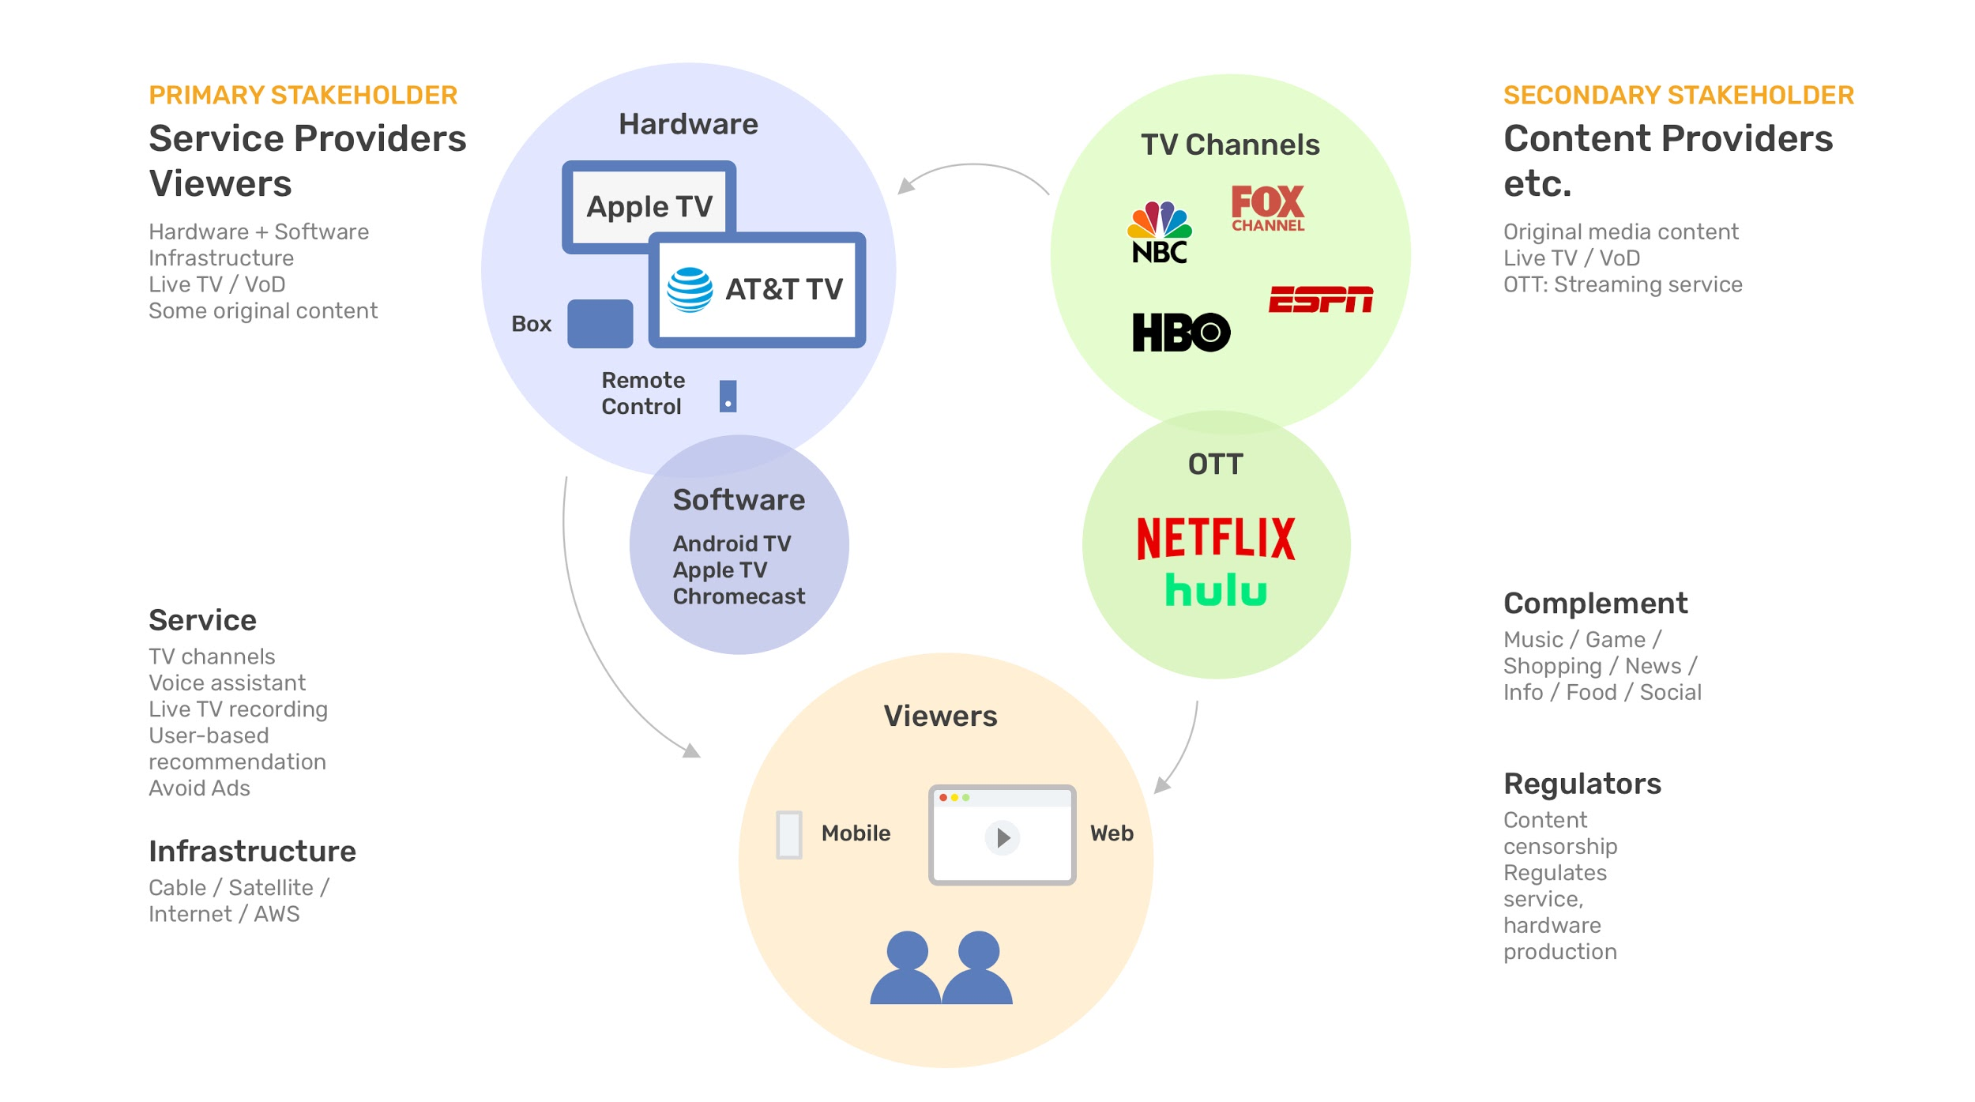

Slide 11
Thank you

